Slide 1

EMPLOYEE PAYROLL SYSTEM
PRESENTED BY:
SRAVANTHI
HARSHINI
KEERTHIKA
DINESH
DEPARTMENT OF CSE

Slide 2

OVERVIEW OF RESEARCH CONTENTS
ABSTRACT
INTRODUCTION
APPLICATIONS
EXISTING METHODOLOGY
DRAWBACKS
PROPOSED METHODOLOGY
ADVANTAGES
ARCHITECTURE
RESULTS
CONCLUSION

Slide 3

ABSTRACT
The Employee payroll System is designed to manage employee salary details , leaves applied ,and salary calculations such as HRA,DA,PF, Gross salary and Net salary.
This system reduces manual work and provides faster and more accurate results.

Slide 4

INTRODUCTION
“In many organizations, handling employee salary manually becomes time-consuming and Error-prone.
To solve this problem, we developed a simple
Payroll system using C programming. It stores Employee details, calculates monthly
Salary, and manages leave information
Efficiently.”

Slide 5


APPLICATIONS
This system can be used in HR departments , small
Companies , payroll sections in organizations,
And anywhere salary processing is required.
It is very helpful for maintaining employee data in a
Structured and clear way.

Slide 6

EXISTING METHODOLOGY
Currently , many companies follow manual salary calculations using registers or spreadsheets .
Details like basic salary , leaves and deductions are entered manually .
This method takes more time and has a higher chance of mistakes.

Slide 7

DRAWBACKS OF EXISTING METHOD
This existing manual method has several drawbacks such as:
→More workload for HR
→Frequent calculation mistakes
→No proper storage records previous salary records.
→No automated leave handling

Slide 8


PROPOSED METHODOLOGY
In the proposed system , we automated salary calculation using C program logic.
We used structures to store employee details, loops to process data , and file handling to save and retrieve information.
This makes the entire payroll process faster and more accurate.

Slide 9

ADVANTAGES
The proposed method has many advantages:
→Fast processing
→Accurate results
→Easy to store and retrieve data
→Reduces human error
→Simple interface and easy to use

Slide 10

ARCHITECTURE OF PROPOSED METHODOLOGY
First ,we take the employee inputs
Calculate HRA,DA and PF
Apply leave deductions
Compute gross and net salary
Finally store the results in a file for future reference

Slide 11

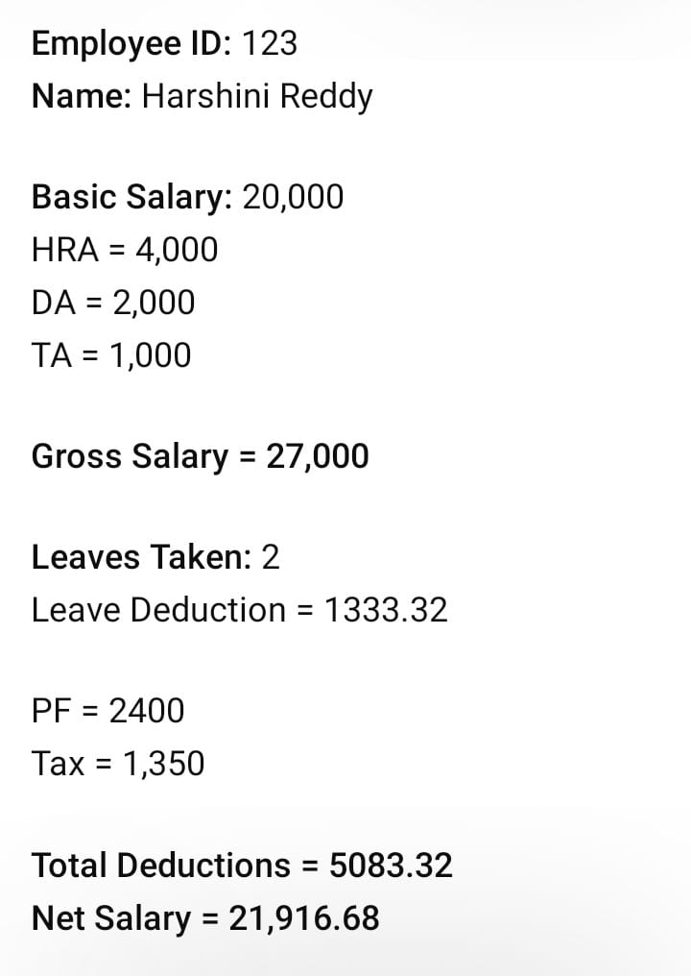
RESULT

Slide 12

CONCLUSION
“To conclude , our employee payroll system is a simple
And efficient solution for managing employee salary information.
It saves time, improves accuracy, and helps maintain records easily.
This project helped us understand C programming
Can be applied to real-world problems..”

Slide 13


